Slide 1
The Social Contract

Slide 2
The Social Contract
The social contract is a theory or model that originated during the Age of Enlightenment and usually concerns the legitimacy of the authority of the state over the individual.
Social contract arguments typically posit that individuals have consented, either explicitly or tacitly, to surrender some of their freedoms and submit to the authority (of the ruler, or to the decision of a majority) in exchange for protection of their remaining rights or maintenance of the social order.
The relation between natural and legal rights is often a topic of social contract theory. The central assertion that social contract theory approaches is that law and political order are not natural, but human creations. The social contract and the political order it creates are simply the means towards an end—the benefit of the individuals involved—and legitimate only to the extent that they fulfill their part of the agreement.

Slide 3
Hobbes, Locke and Rousseau
Hobbes argued that government is not a party to the original contract and citizens are not obligated to submit to the government when it is too weak to act effectively to suppress civil unrest.
According to other social contract theorists, when the government fails to secure their natural rights (Locke) or satisfy the best interests of society (Rousseau’s "general will"), citizens can withdraw their obligation to obey, or change the leadership through elections or other means including, if necessary, violence.
Locke believed that natural rights were inalienable, and therefore the rule of God superseded government authority, while Rousseau believed that democracy (self-rule) was the best way to ensure welfare while maintaining individual freedom under the rule of law. The Lockean concept of the social contract was invoked in the United States Declaration of Independence.

Slide 4
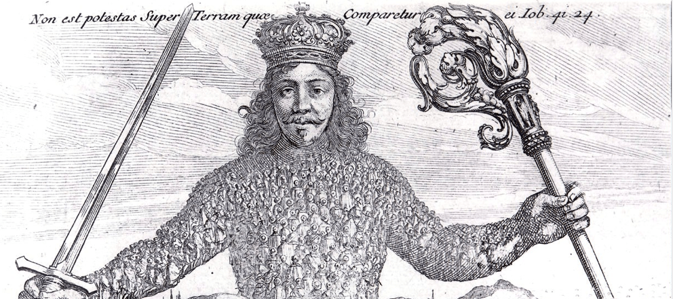
Leviathan, Thomas Hobbes, 1651
There is no power on earth to be compared with him. (Book of Job).

Slide 5
Thomas Hobbes – on the State
  Moral and legal rules created for everyone’s mutual protection, e.g., agree not to kill others in order to not be killed
  To avoid the brutality of the Natural State, we agree to the authority of a strong sovereign
  Self-interest compels entering into a social contract
  Thus, morality is not a heavenly or divine matter
  An ego-centered, not God-centered justification for absolute authority

Slide 6
Hobbes – on Property
Private property is not a natural condition of the natural state of man.
It is a creation of the sovereign state. It does not exist if the state (the king) says it doesn’t.
Private property cannot exist in the absence of rules established and enforced by the sovereign.

Slide 7
John Locke – on the State
  Man has natural rights before any government arises
  Natural rights come from God, as does all of creation
  Government exists to protect these natural rights
  Our principal natural right is private property
    How and why is this so?

Slide 8
Locke’s Labor Theory of Property
Though the earth, and all inferior creatures, be common to all men, yet every man has a property in his own person: this no body has any right to but himself. The labour of his body, and the work of his hands, we may say, are properly his. Whatsoever then he removes out of the state that nature hath provided, and left it in, he hath mixed his labour with, and joined to it something that is his own, and thereby makes it his property. It being by him removed from the common state nature hath placed it in, it hath by this labour something annexed to it, that excludes the common right of other men: for this labour being the unquestionable property of the labourer, no man but he can have a right to what that is once joined to, at least where there is enough, and as good, left in common for others. (Second Treatise of Government, 1689, Chapter V, paragraph 27).

Slide 9
Locke’s Proviso
“Nor was this appropriation of any parcel of land, by improving it, any prejudice to any other man, since there was still enough and as good left, and more than the yet unprovided could use. So that, in effect, there was never the less left for others because of his enclosure for himself. For he that leaves as much as another can make use of, does as good as take nothing at all. Nobody could think himself injured by the drinking of another man, though he took a good draught, who had a whole river of the same water left him to quench his thirst. And the case of land and water, where there is enough of both, is perfectly the same.” (Second Treatise of Government, 1689, Chapter V, paragraph 33).

Slide 10
Jean-Jacques Rousseau – on Government
Man in the State of Nature is altruistic and good, because in the Natural State we live in small communities with abundant resources. In the Natural State most of us are “Noble Savages”.
Just as individuals naturally pursue their own self-interests, government exists to advance the common will of the people.

Slide 11
Jean-Jacques Rousseau – on Property
The invention of private property represents man’s fall from grace out of the state of nature.
“The first man who, having fenced in a piece of land, said 'This is mine', and found people naïve enough to believe him, that man was the true founder of civil society. From how many crimes, wars, and murders, from how many horrors and misfortunes might not any one have saved mankind, by pulling up the stakes, or filling up the ditch, and crying to his fellows: ‘Beware of listening to this impostor; you are undone if you once forget that the fruits of the earth belong to us all, and the earth itself to nobody.’” (Discourse on Inequality, 1755).

Slide 12
Rise of Democracy
“We hold these truths to be self-evident, that all Men are created equal, that they are endowed by their Creator with certain inalienable rights, that among these are Life, Liberty and the pursuit of Happiness.” Declaration of Independence, 1776.

Slide 13
Locke, Private Property, and the emergence of the Industrial Revolution
Professor’s note: Think about the shift in the Western social psyche during this part of Modernity. Man increasingly sees his place in the universe and in society differently. Increasingly, to understand man’s relationship to man, and to society, you have to understand man’s relationship not to God’s creation, but to Man’s creation – Property (materialism).
Question: Are not today’s social organizations (corporations, governments) designed to enforce and perpetuate this?

